Slide 1
The Measurement of Inequality
Rajiv Sethi and the CORE Team
October 20, 2021

Slide 2
Overview
The meaning of inequality
Visualization using Lorenz Curves
Measurement using the Gini coefficient
Market and disposable income
The Gini Coefficient
Reading: The Economy 5.12 to 5.14 and A World of Differences Sections 1-3

Slide 3
Measuring Inequality
Economic inequality is among the defining issues of our time
Multiple dimensions: income, wealth, opportunity, status, etc.
How do we visualize and measure inequality?
Lorenz curves used for visualization comparison across time and space
Gini coefficients used as a single-number measure

Slide 4
Lorenz Curves

Slide 5
Lorenz Curves
Suppose population size is n (individuals, families, countries)
Suppose total income is X
Sort population in order of increasing income
At each income level, calculate cumulative share of population below
And calculate cumulative share of income held by this group
Example: 100 farmers, 90 own no land, rest own 100 acres each
90% of population has cumulative share 0, 100% has cumulative share 100
How do we visualize inequality in landholding?
What if each farmer had 10 acres each (perfect equality)?

Slide 6
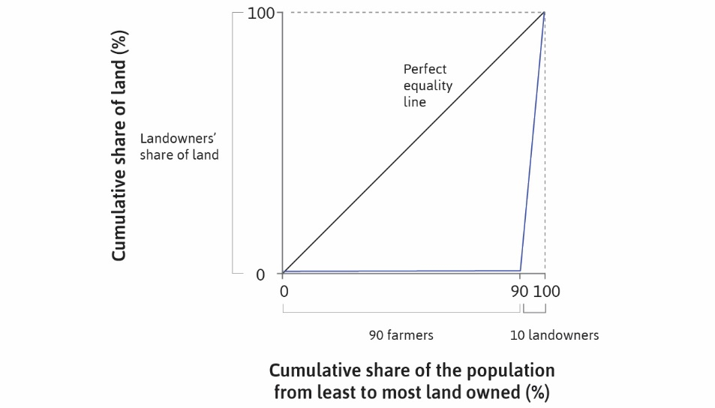

Slide 7
Example
Consider a group of eight persons
Incomes as shown on next slide
Range between $10 and $500
Sum of incomes is $1,000
To compute Lorenz curve, first sort data
Then compute cumulative population and cumulative income shares
Then plot along with line of perfect equality

Slide 8
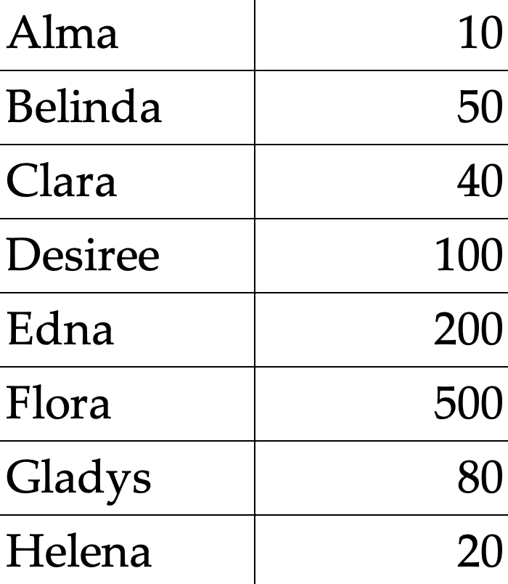

Slide 9
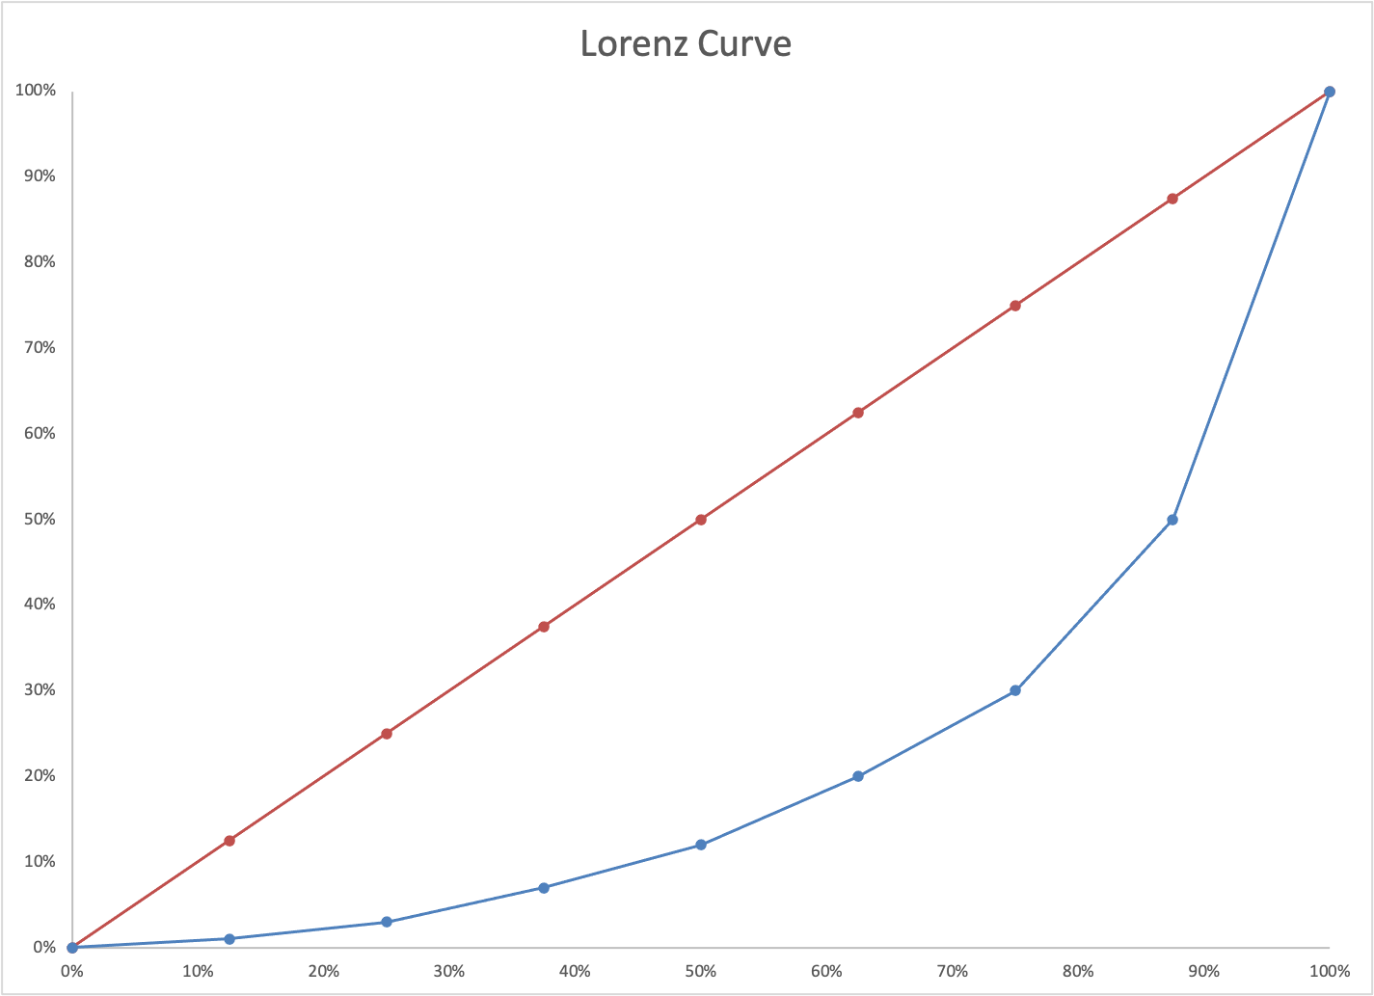

Slide 10
Gini Coefficient
If one Lorenz curve lies below another we can compare levels of inequality
But what if the curves cross?
Then the two distributions can’t be unambiguously ranked
Gini coefficient provides a scalar measure of inequality
This allows comparison between any pair of distributions
Let A denote area between Lorenz curve and equality line
Let B denote area below Lorenz curve
Gini (area measure) is ratio of A to A + B

Slide 11
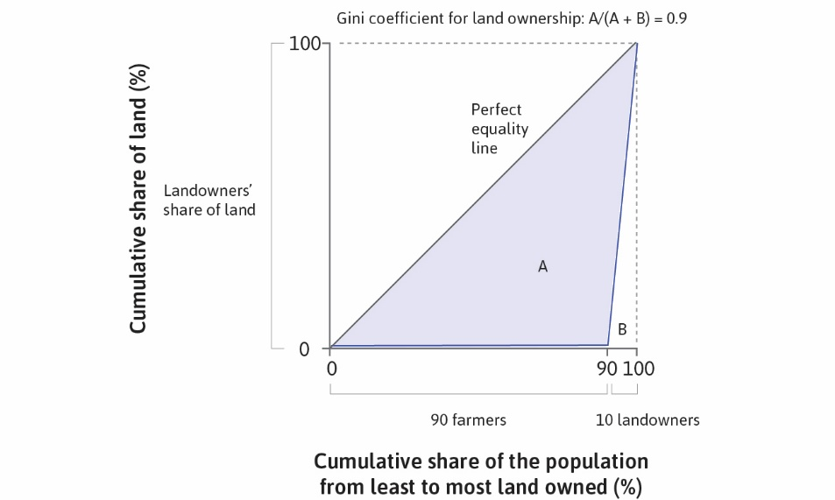

Slide 12
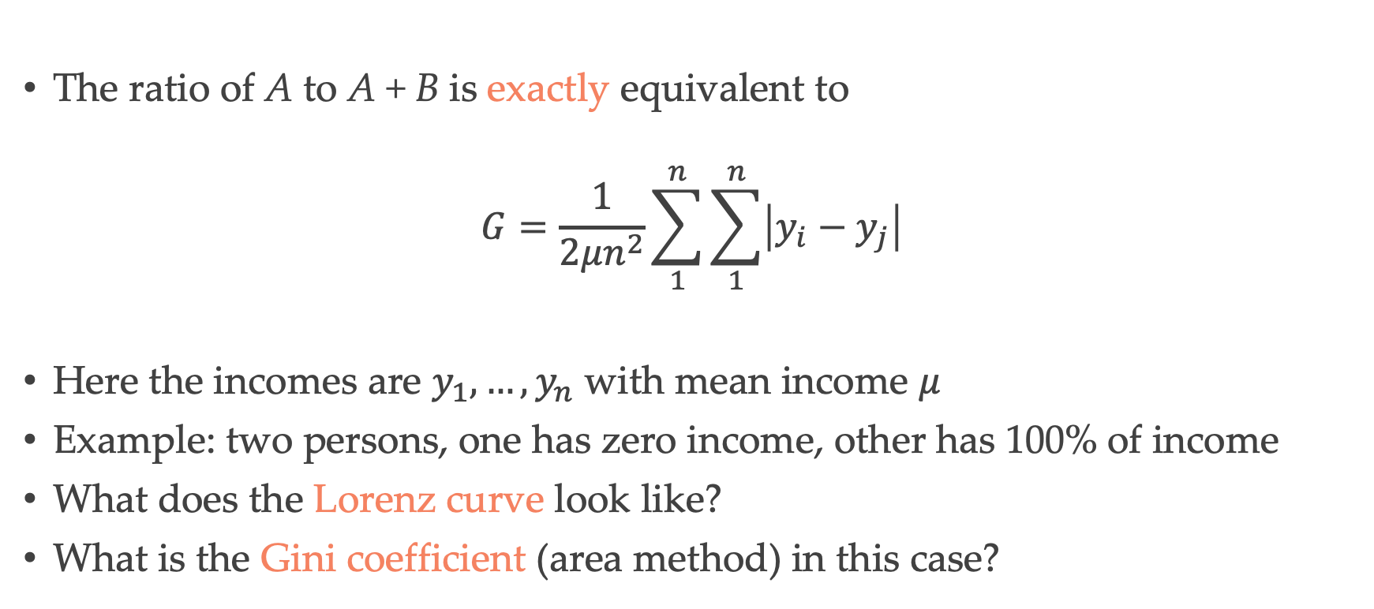
Gini Coefficient (area method)
The ratio of A to A + B is exactly equivalent to
$$G=\frac{1}{2μn^{2}}\sum_{1}^{n}{\sum_{1}^{n}{\left|y_{i}−y_{j}\right|}}$$
Here the incomes are $y_{1},…,y_{n}$ with mean income $μ$
Example: two persons, one has zero income, other has 100% of income
What does the Lorenz curve look like?
What is the Gini coefficient (area method) in this case?

Slide 13
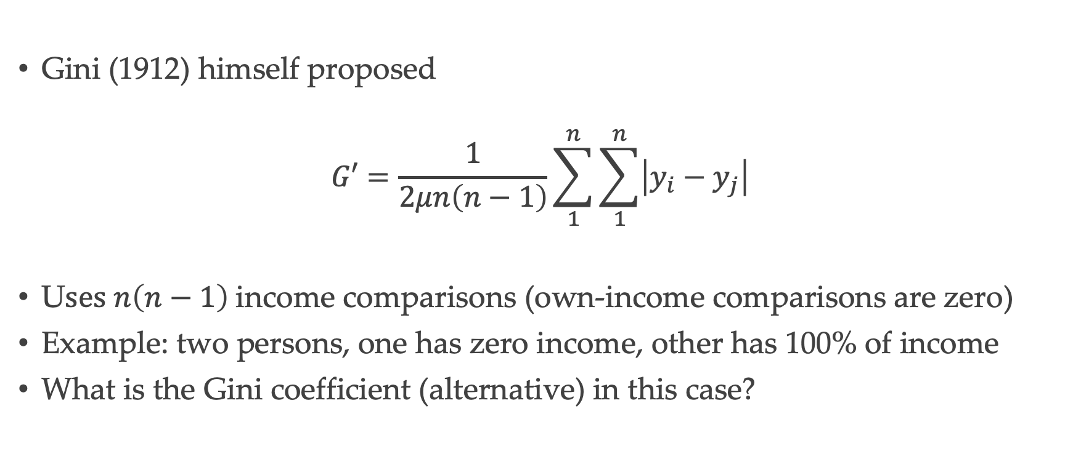
Gini Coefficient (alternative)
Gini (1912) himself proposed
$$G′=\frac{1}{2μn\left(n−1\right)}\sum_{1}^{n}{\sum_{1}^{n}{\left|y_{i}−y_{j}\right|}}$$
U$ses n\left(n−1\right)$income comparisons (own-income comparisons are zero)
Example: two persons, one has zero income, other has 100% of income
What is the Gini coefficient (alternative) in this case?

Slide 14
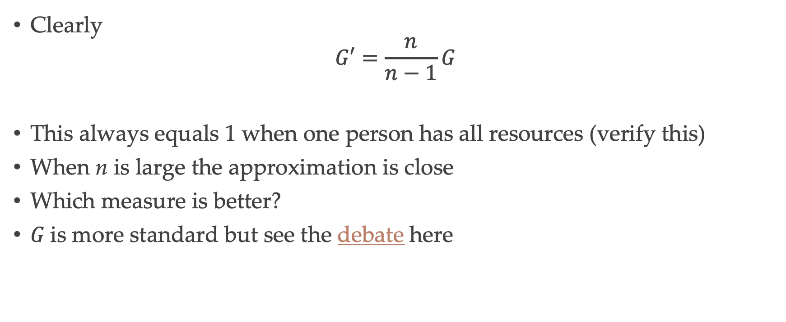
Gini Coefficient(s)
Clearly
$$G′=\frac{n}{n−1}G$$
This always equals 1 when one person has all resources (verify this)
When n is large the approximation is close
Which measure is better?
$G$is more standard but see the debate here

Slide 15


Slide 16
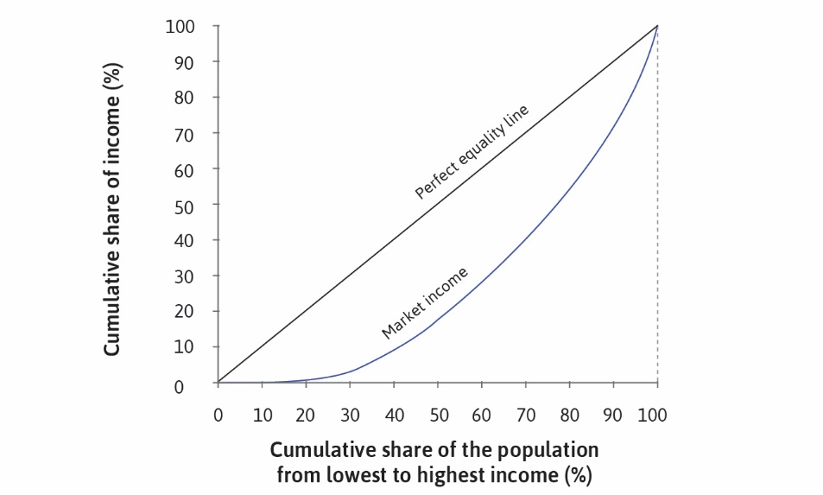

Slide 17
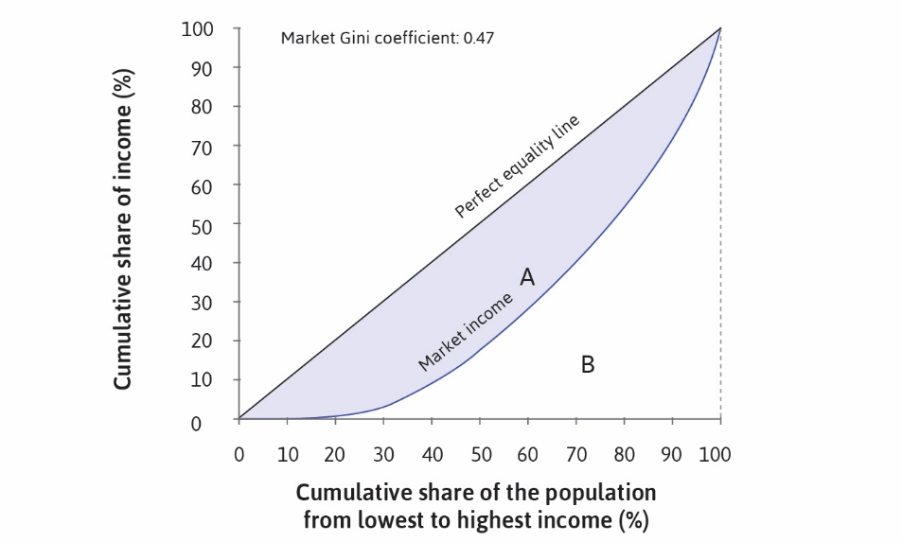

Slide 18
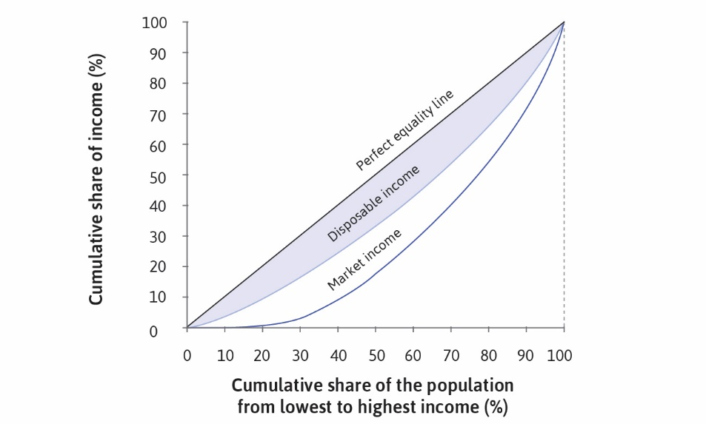

Slide 19
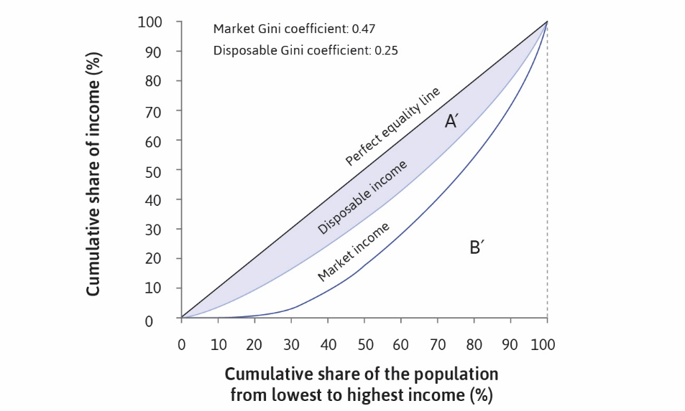

Slide 20
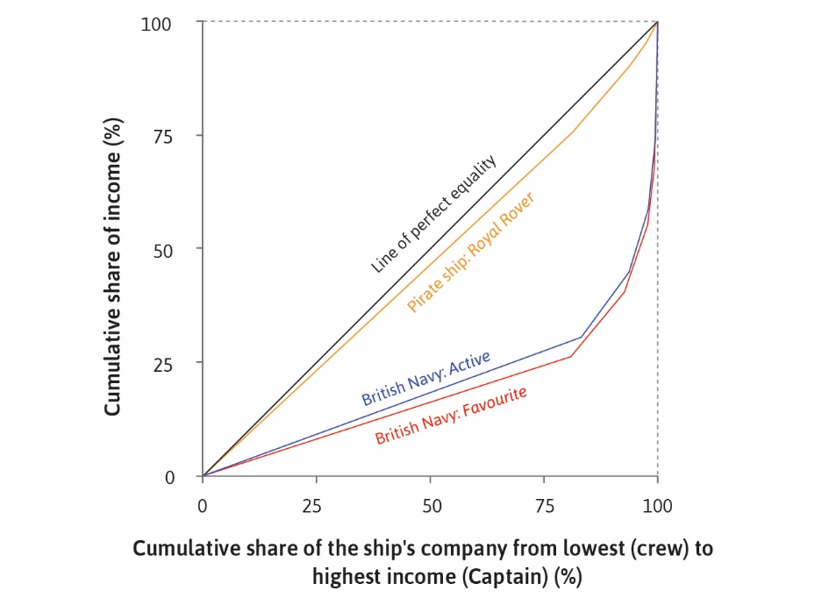

Slide 21
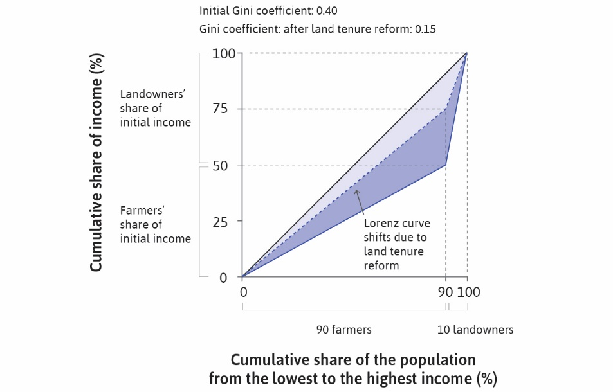

Slide 22
